Slide 1


Strategic framework
«Latvia 2050»
University of Latvia Prof. Inna Šteinbuka

Slide 2
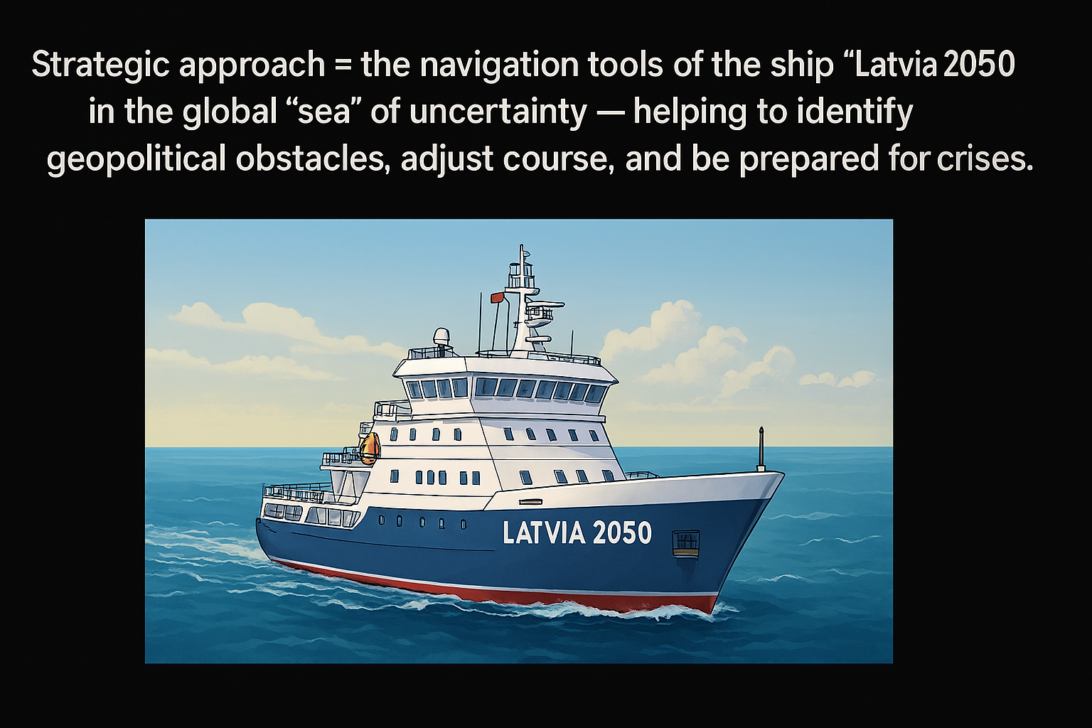

Slide 3
Three narratives: “Latvia 2050”
Without the state, there is no welfare!
Without welfare, there is no culture!
Without the Latvian language and culture, the state has no meaning!

Slide 4



LV2050 — NINE AREAS ANALYSED
Human capital
TYPEU OF LINKS
Civil society
Technologies
Enabler
A makes B possible
Catalyst
A accelerates the development of B
Governance
STATE EXISTENCE
WELFARE
LANGUAGE/CULTURE
Competitiveness
Critical
A is a precondition for B
Mutual
A and B reinforce each other
Tension
A un B ir trade-off
Environment
Innovation
Synergy
A+B > A + B separately
Cultural
Value dimension
Security
Financial system

Slide 5




LV2050 — GLOBAL COMPETITIVENESS
AREA
CHALLENGES
DILEMMAS
GOALS 2050
KEY TASKS
KPI
GLOBAL COMPETITIVENESS
Rising costs, competitive risks
Balance between short-term cost reduction and long-term investment in human capital, technologies, and innovation.
The dilemma in raising productivity — whether to strengthen the existing economic structure or promote structural changes aimed at higher value-added activities.
Balance labour-cost and productivity development
Investment in technologies
Efficient and innovative infrastructure
Support for productive companies
Productivity per capita reaches the EU average

Slide 6
Over the last ten years, productivity dynamics in Latvia have been volatile. Although productivity in Latvia is growing faster than the EU average, the productivity gap remains large
Productivity convergence with the EU average
Latvia’s productivity gap, lagging behind EU-27, percentage points
Source: EUROSTAT

Slide 7
Key factors driving productivity growth
INVESTMENT AND INCREASING CAPITAL INTENSITY - improving the investment environment, developing the capital market, and ensuring effective absorption of EU funds;
THE ABILITY TO INTEGRATE INTO GLOBAL VALUE CHAINS AND INCREASE EXPORT POTENTIAL - diversifying and upgrading exports, moving from low-cost to quality-factor competitive advantages;
DIGITALISATION, AI ADOPTION, INNOVATION, AND THE DEVELOPMENT OF NEW PRODUCTS, SERVICEU, AND METHODS - increasing R&D funding, strengthening the innovation ecosystem, and deepening cooperation between academia and the private sector;
INVESTMENT IN HUMAN CAPITAL - including STEM training, lifelong learning, and aligning skills with labour-market demand;
REDUCING BUREAUCRACY AND IMPROVING THE BUSINEUS ENVIRONMENT - as a precondition for all other factors to work effectively.

Slide 8



LV2050 — TECHNOLOGY AND DIGITALISATION
AREA
CHALLENGE
DILEMMAS
GOALS 2050
KEY TASKS
KPI
TECHNOLOGY AND DIGITALISATION
Lack of digital skills, digital divide
Balancing goals of achieving short-term results and ensuring long-term structural change.
A balance between economic efficiency and social inclusion (employment).
Be among the EU leaders in technologies and digitalisation
Raising skills in all age groups
Digitalisation of companies
AI adoption
Development of e-government
90% of the population with digital skills
100% of the population uses
e-services
At least 90% of companies use digital and AI tools

Slide 9
Technologically, we are capable of significantly increasing the production and export of highly complex products. However, since 2012 Latvia’s position in the ranking has barely changed — the economic transformation process has slowed
EU countries’ positions in The Atlas of Economic Complexity export economic complexity ranking in 2012 and 2024

Slide 10
Latvia’s level of digital development is below the EU average
DIGITAL ECONOMY INDICATORS AND EU DIGITAL DECADE POLICY PROGRAMME TARGETS
SMEs WITH AT LEAST A BASIC LEVEL OF DIGITAL INTENSITY
% of total SMEs
DIGITAL SKILLS
At least basic digital skills, % of population
ARTIFICIAL INTELLIGENCE
share of enterprises using at least one artificial intelligence technology, %
CLOUD COMPUTING
share of enterprises using at least one cloud-computing service, %
Source: European Commission, Digital Decade Policy Programme

Slide 11



LV2050 — INNOVATION CAPACITY
AREA
CHALLENGE
DILEMMAS
GOALS 2050
KEY TASKS
KPI
INNOVATION CAPACITY
Slow diffusion of innovation, low investment
Balancing short-term goals and long-term transformative innovation
Strengthen innovation and financing R&D
Support for intangible assets
State support for innovation
Flexible regulation
R&D expenditure >3% of GDP
85% of companies engaged in innovation

Slide 12
Productivity dynamics are affected by a low level of private investment
Net value of accumulated non-financial assets (constant prices) per person employed and productivity in EU countries, thousand EUR

Slide 13



LV2050 — HUMAN CAPITAL AND DEMOGRAPHY
AREA
CHALLENGEU
DILEMMAS
GOALS 2050
KEY TASKS
KPI
HUMAN CAPITAL AND DEMOGRAPHY
Depopulation, ageing society, emigration and immigration
How can the renewal and sustainability of society be ensured while preserving national identity and economic viability?
To what extent should we address immediate labour-market needs, and to what extent should we invest in promoting long-term growth and innovation potential?
Stop population decline, increase support for families with children, and ensure the sustainability and quality of the workforce
Strengthening the value of families with children
State support for families with children
Promoting fertility
Ensuring a balance between the workforce and pensioners
Total fertility rate of at least 1.88 births
Life expectancy: men 77, women 84 years
66 healthy life years 50% of the population with higher education
Employment rate 78%

Slide 14
Key human-capital challenges
Workforce decline since 2000 Latvia has lost ~1/5 of its population;
Qualification mismatch indicator rose from 31.1% (2017) to 36.1% (2024);
STEM and excellence gap: the share of STEM graduates is below the EU average;
Top PISA performance in mathematics is only 6% (OECD average 9%);
Only 11% participate in lifelong learning among adults (25–64) — one of the lowest rates in the EU, hindering the workforce transition to more productive sectors.
Population participation rate in lifelong learning
(population aged 25–64, percent)
Source: EUROSTAT

Slide 15



LV2050 — THREE MACROECONOMIC SCENARIOS
2.
INERTIA WITH SLOW GROWTH AND DEMOGRAPHIC PRESSURE
3.
NEGATIVE
SPIRAL
1. TRANSFORMATIVE RESILIENCE

Slide 16

1. TRANSFORMATIVE RESILIENCE
Major structural reforms and a transition to a knowledge-intensive, green, and digital economy
Breakthrough in GDP and productivity
Positive solutions to demographic and migration challenges, and social cohesion
Increasing public-administration and policy-implementation capacity and moving closer to the EU welfare level

Slide 17

2. INERTIA WITH SLOW GROWTH AND
DEMOGRAPHIC PRESSURE

Slide 18

3. NEGATIVE SPIRAL
Weak demographics, productivity, and structural inertia reinforce the economic slowdown
GDP dynamics are stagnant, increasing pressure on pension and social-protection systems
Population decline causes a shrinking workforce and tax base
Technological and productivity lag, moving further away from the EU welfare level

Slide 19
A START FOR PRODUCTIVE CONVERSATIONS ABOUT LATVIA!

