Slide 1

THE ROLE OF
THE LEADER IN CREATING A
VALUES-DRIVEN ORGANIZATION
Richard Barrett
Barrett Academy for the Advancement of Human Values (www.barrettacademy.com)

Slide 2
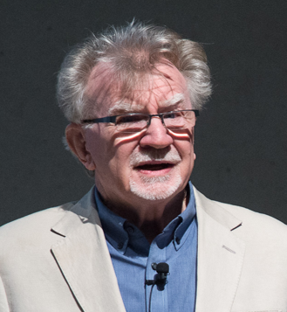

Founder of the Barrett Values Centre
To create a values-driven world where all people , organizations and societies thrive.

Slide 3
President of the Academy for the Advancement of Human Values
To discover, incubate and develop ideas and concepts that support the evolution of human consciousness.

Slide 4
“Values-driven organizations are the most successful on the planet because they care about their stakeholders needs.”
Richard Barrett

Slide 5

WHAT ARE VALUES?
The ENERGETIC DRIVERS of our aspirations and intentions.
The ENERGETIC DRIVERS of our aspirations and intentions.

Slide 6

WHY ARE VALUES
IMPORTANT?
The decisions we make are a reflection of our values, and they are always directed towards a specific purpose—
the satisfaction of our individual and collective needs.

Slide 7

Whatever we need is what we value.
OUR VALUES ARE AN EXPRESSION OF OUR NEEDS

Slide 8
WHEN OUR NEEDS ARE SATISFIED, WE FEEL A SENSE OF WELLBEING.

Slide 9
In a rapidly changing world VALUES provide the anchors we need to guide our decision-making.

Slide 10


Cultural health and employee well-being are the pathways to sustainable performance.
“Values-driven organizations are the most successful on the planet.”

Slide 11
WHAT IS CULTURE?
The values, beliefs and behaviours that guide and define the way in which a group of people work together.

Slide 12

THE LEADERS
WHO CREATES THE CULTURE?

Slide 13

Therefore if you want to change the culture:
The Leaders Must Change
or You Must Change the Leaders

Slide 14
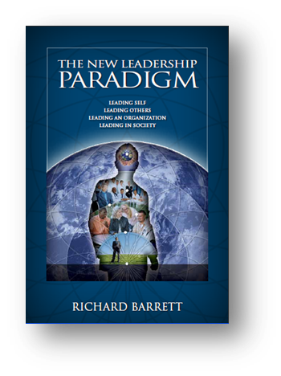
Focus on Leading Self, Leading a Team, Leading an Organization and Leading in Society.
“Organizational transformation begins with the personal transformation of the leaders.”

Slide 15

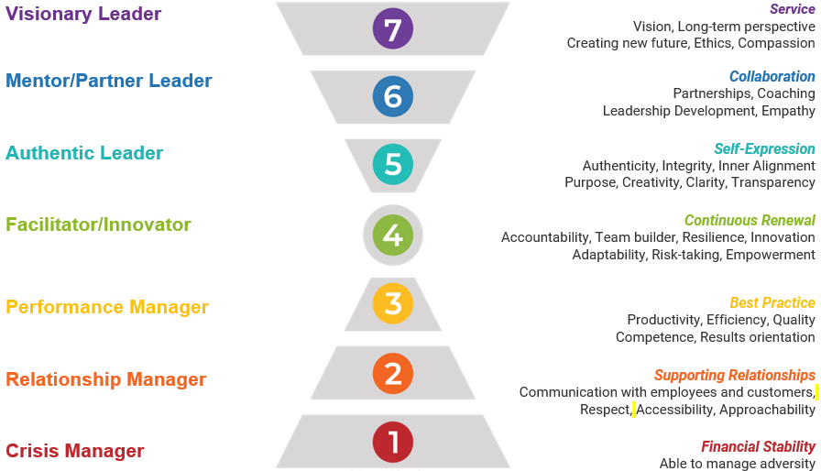
The Seven Levels of
Leadership Development

Slide 16
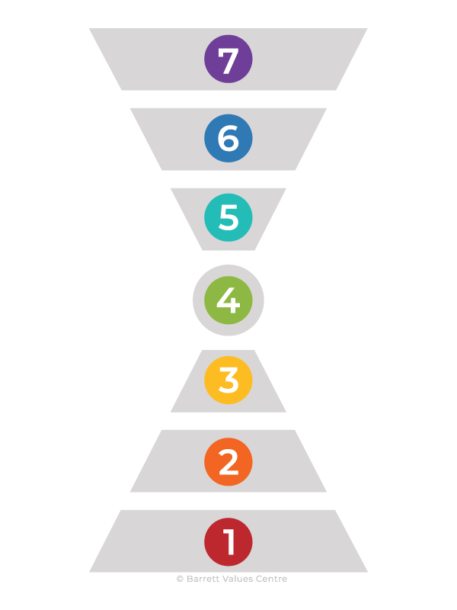
The Seven Levels of
Leadership Development
Leader
Transition
Manager

Slide 17
CRISIS MANGER
FOCUS
Financial stability, and health and welfare of employees.

Slide 18
CRISIS MANAGER
They understand the importance of good financial management. They manage their budgets meticulously.
They are appropriately cautious in complex situations but are willing to take risks that do not compromise the organization’s resilience and future.
They maintain a long-term perspective while dealing with short-term issues and goals.

Slide 19

Without access to a continuing to funds and investment, organizations
quickly perish.
Every organization needs to make financial stability a primary concern.

Slide 20
RELATIONSHIP MANAGER
FOCUS
Harmonious interpersonal relationships and good internal communications.

Slide 21
RELATIONSHIP MANAGER
Relationship managers invest a lot of time in building harmonious working relationships.
They know how to manage conflicts because they know how to handle their emotions and respond to the emotions of others.
They believe in open communication.
They acknowledge and praise staff for a job well done. They are accessible
to their employees.

Slide 22

The critical issue at this stage of development is to create a sense of loyalty and belonging with open communication, mutual respect and conflict resolution.

Slide 23

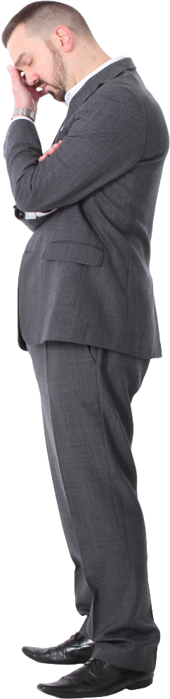
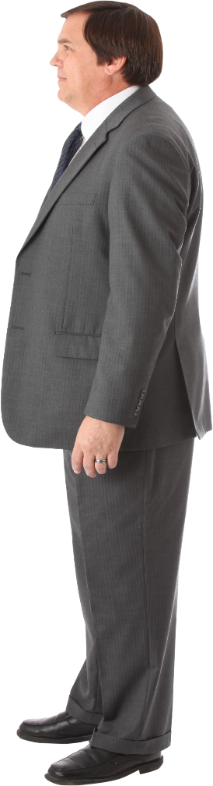
When the leaders are more focused on their own success rather than the success of the organization, they begin to compete with each other.
When leaders display territorial behaviours, blame, internal competition and internal politics ensue.

Slide 24
PERFORMANCE MANAGER
FOCUS
Efficiency, excellence, productivity, quality and professionalism.

Slide 25
PERFORMANCE MANAGER
Brings logic and science to their work. They use metrics to manage performance. They build systems and processes that create order and efficiency and enhance productivity.
They have strong analytical and technical skills. They are experts in their fields. They think strategically and move quickly to capitalize on opportunities.
They are rational in decision-making. They plan and prioritize their work and provide stability and continuity.

Slide 26

A precondition for continuous performance improvement is the encouragement and reward of excellence.

Slide 27
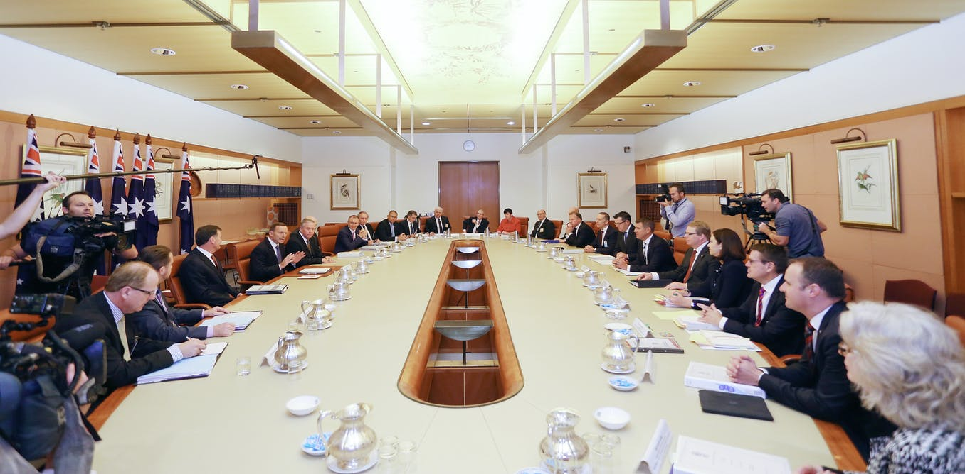
Organizations that get stuck in the third level of leadership tend to be structured hierarchically for the purposes of central bureaucratic control.

Slide 28
FACILITATOR/INNOVATOR
FOCUS
Adaptability, employee empowerment, continuous renewal
and continuous learning.

Slide 29
FACILITATOR/INNOVATOR
Readily seek advice, build consensus, and empower their staff. They give people responsible freedom, making them accountable for outcomes and results.
They resist the temptation to micromanage the work of their direct reports. They promote participation, equality, and diversity. They are adaptable and flexible.
They embrace continuous learning. They actively engage in their personal development and encourage their staff to do the same.

Slide 30

To fully respond to the challenges of this level of consciousness the leader must actively garner employees’ ideas and opinions.
For many leaders and managers, this is a new role requiring new skills. Employees want to be accountable—not micro-managed and supervised every moment of every day.

Slide 31
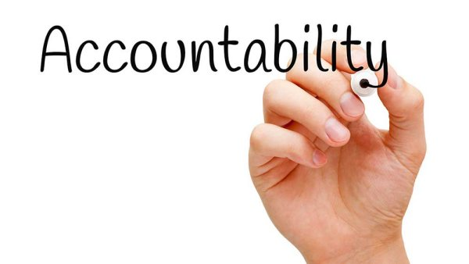
More accountability is given to everyone and structures become less hierarchical. Teamwork is encouraged and more attention is given to personal develop-ment and relationship skills. Diversity is seen as a positive asset in exploring new ideas.

Slide 32
AUTHENTIC LEADER
FOCUS
Internally cohesive organization that has a capacity for collective action.

Slide 33
AUTHENTIC LEADER
A self-actualized individual who has discovered his or her sense of purpose.
They promote a shared set of values and demonstrate congruent behaviours that guide decision-making.
They demonstrate integrity and are living examples of values-based leadership.
They walk their talk. They build internal cohesion and focus by creating a shared purpose.

Slide 34
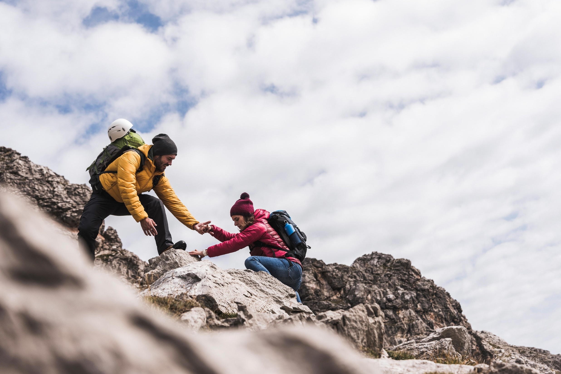
A precondition for success at this stage of development is to build a climate of TRUST.

Slide 35


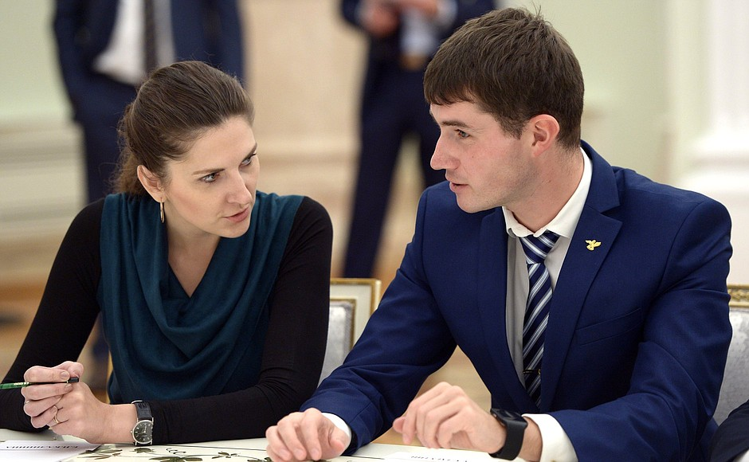
VISION VALUES
PURPOSE
A critical requirement is a shared vision of the future that inspires employees, a shared set of values that provides guidance for decision making, and an strong organizational purpose.

Slide 36
MENTOR/PARTNER
FOCUS
High level of internal connectedness and external connectedness through strong collaboration.

Slide 37
MENTOR/PARTNER
Create a working environment where individuals are encouraged, supported, and empowered to fulfil their potential.
They create mutually beneficial partnerships and strategic alliances with other departments and communities. They collaborate to create win-win situations.
They go beyond the needs of compliance in making their operations environmentally friendly and socially responsible.

Slide 38
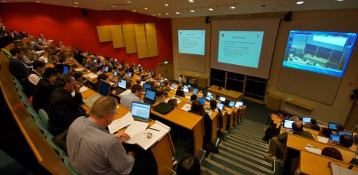



Leadership development is given significant emphasis at this stage of development.
The organization should support employees in becoming all they can become, both professionally and personally.

Slide 39
VISIONARY LEADER
FOCUS
The well-being of society, the planet and future generations.

Slide 40
VISIONARY LEADER
A holistic perspective on life. Because they can rely on their wisdom, they can handle multiple levels of complexity.
They care about their organization, and they also care about the world. They care about their employees, and they also care about future generations. They see the purpose of the organization from a larger, societal perspective.
They are committed to social responsibility and ethics. They support the United Nations Sustainable Development Goals.

Slide 41


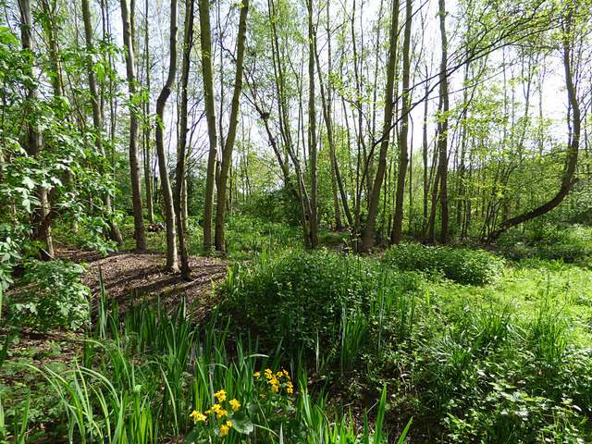
The critical issue at this level of consciousness is developing a deep sense of social responsibility by caring about social justice, ecology and human rights.
SOCIAL JUSTICE
ECOLOGY
HUMAN RIGHTS

Slide 42

The organization takes great care to make sure their activities, products and services are in alignment with the UN’s Sustainable Development Goals.

Slide 43

Objectives of the UN Sustainable Development Goals
To live in harmony with nature, the planet and all life on earth
To create conditions for every human being on earth to have the opportunity to experience wellbeing, contentment and peace
Notes:
Physical, emotional, mental and spiritual wellbeing

Slide 44
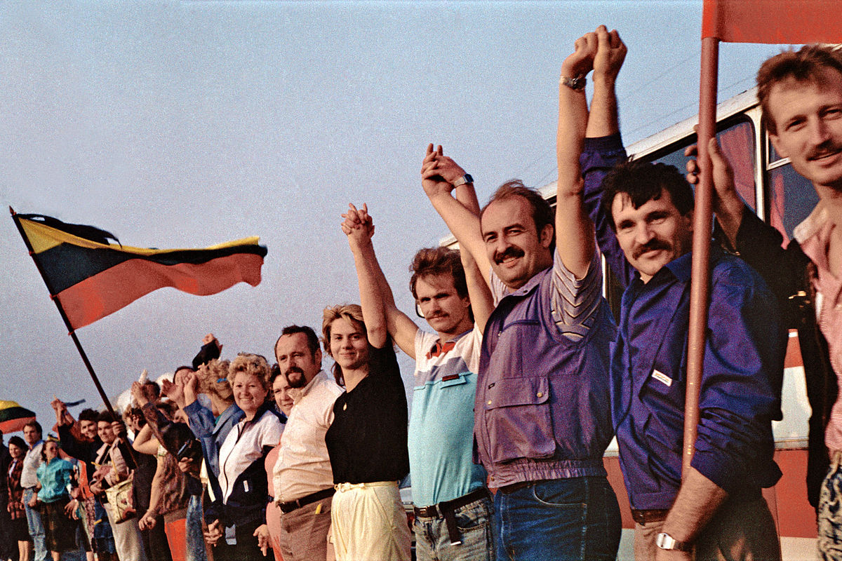
THE ULITMATE GOAL OF THE LEADERSHIP PROGRAM?
To increase the WELLBEING of the
citizens of Latvia.

Slide 45

MEASUREMENT MATTERS
MEASURING
ORGANIZATIONAL CULTURE
WHATEVER YOU MEASURE TENDS
TO IMPROVE

Slide 46


Cultural Evolution begins with the Personal Evolution of the Leaders
Leadership 360 Feedback
(14 Assessors)
Organisation
Current Culture
continuous learning generosity commitment positive attitude vision ambitious making a difference results orientation honesty integrity intuition leadership developer | Level 4 5 5 5 7 3 6 3 5 5 6 6
customer satisfaction commitment continuous learning making a difference global perspective mentoring enthusiasm leadership development integrity open communication optimism shared values | Level 2 5 4 6 7 6 5 6 5 2 5 5
Leadership Entropy 9%
Cultural Entropy 7%

Slide 47

Cultural Evolution begins with the Personal Evolution of the Leaders
Leadership 360 Feedback
(14 Assessors)
Organisation
Current Culture
power blame demanding manipulation experience controlling arrogant authoritarian exploitative ruthless | Level 3 2 3 2 3 1 3 1 1 1
short-term focus blame manipulation caution cynicism bureaucracy control cost reduction empire building image long hours | Level 1 2 2 1 3 3 1 1 2 3 3
Leadership Entropy 64%
Cultural Entropy 38%

Slide 48
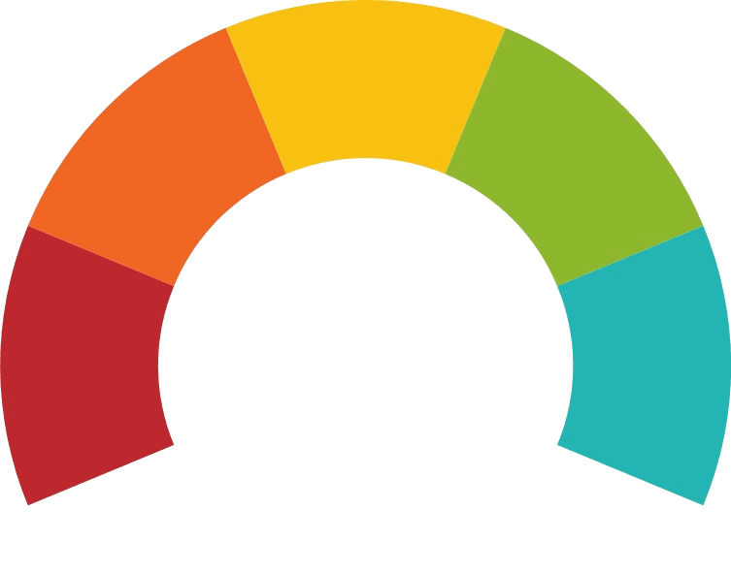





Culture Score
Misaligned Culture Example
1403 participants
This is the benchmark metric reflecting the health and strength of a culture.
FAIR
The score is based on matches, Cultural Entropy® and balance between the levels.
POOR
GOOD
Very Poor
21
Very Good
Global Average: 49
Regional Average: 50
Industry Average: 42

Slide 49
















Overall Group Results
Misaligned Culture Example
1403 participants
Personal Values (PV)
Contribution Collaboration
Alignment Evolution Performance
Relationships Viability
Current Culture Values (CC)
Desired Culture Values (DC)
VALUE | VOTES | LEVEL |  | VALUE | VOTES | LEVEL |  | VALUE | VOTES | LEVEL
honesty | 599 | 5 |  | customer satisfaction | 702 | 2 |  | accountability | 611 | 4
accountability | 571 | 4 |  | cost reduction | 575 | 1 |  | customer satisfaction | 561 | 2
respect | 441 | 2 |  | confusion | 546 | 3 |  | continuous learning | 459 | 4
caring | 439 | 2 |  | bureaucracy | 505 | 3 |  | financial stability | 435 | 1
positive attitude | 432 | 5 |  | brand image | 453 | 3 |  | teamwork | 431 | 4
commitment | 411 | 5 |  | job insecurity | 395 | 1 |  | open communication | 405 | 2
humor/ fun | 410 | 5 |  | hierarchy | 373 | 3 |  | employee fulfillment | 394 | 6
integrity | 404 | 5 |  | information hoarding | 345 | 3 |  | information sharing | 372 | 4
continuous learning | 392 | 4 |  | continuous learning | 307 | 4 |  | employee recognition | 339 | 2
creativity | 368 | 5 |  | innovation | 305 | 4 |  | long-term perspective | 332 | 7
Positive Value
Potentially Limiting
PV & CC
0 Matches
PV & DC
1 Matches
CC & DC
2 Matches
PV, CC & DC
0 Matches
Top ten Personal Values
Top ten Current Culture Values
Top ten Desired Culture Values

Slide 50
Cultural Entropy® Report
Misaligned Culture Example
1403 participants
Viability
12%
of total votes
Relationships
7%
of total votes
Performance
17%
of total votes
POTENTIALLY LIMITING VALUES | VOTES |  | POTENTIALLY LIMITING VALUES | VOTES |  | POTENTIALLY LIMITING VALUES | VOTES
cost reduction | 575 |  | blame | 238 |  | confusion | 546
job insecurity | 395 |  | internal competition | 211 |  | bureaucracy | 505
short-term focus | 250 |  | manipulation | 169 |  | hierarchy | 373
control | 241 |  | discrimination | 104 |  | information hoarding | 345
caution | 145 |  | empire building | 93 |  | silo mentality | 266
 |  |  | harassment | 83 |  | long hours | 200
 |  |  |  |  |  | power | 146
0%—13% | 14%—19% | 20%—28% | 29%+
36%

Slide 51


Culture Score
Aligned Culture Example
521 participants
This is the benchmark metric reflecting the health and strength of a culture.
Fair
The score is based on matches, Cultural Entropy® and balance between the levels.
Poor
Good
Very Poor
89
Very Good
Global Average: 49
Regional Average: 48
Industry Average: 44

Slide 52













Overall Group Results
Aligned Culture Example
521 participants
Personal Values (PV)
Contribution Collaboration Alignment
Evolution
Performance Relationships Viability
Current Culture Values (CC)
Desired Culture Values (DC)
VALUE | VOTES | LEVEL
humour/ fun | 207 | 5
balance (home/work) | 202 | 4
family | 173 | 2
honesty | 166 | 5
fairness | 161 | 5
positive attitude | 160 | 5
supporting others | 145 | 2
commitment | 143 | 5
caring | 140 | 2
respect | 133 | 2
VALUE | VOTES | LEVEL
client collaboration | 217 | 6
well-being | 207 | 6
balance (home/work) | 198 | 4
teamwork | 151 | 4
continuous improvement | 135 | 4
innovation | 135 | 4
financial stability | 127 | 1
professionalism | 127 | 3
trust | 121 | 5
professional growth | 120 | 3
VALUE | VOTES | LEVEL
professional growth | 237 | 3
balance (home/work) | 228 | 4
well-being | 201 | 6
employee engagement | 186 | 5
employee recognition | 181 | 2
continuous improvement | 175 | 4
innovation | 150 | 4
teamwork | 150 | 4
client collaboration | 149 | 6
entrepreneurial | 127 | 4
Positive Value
Potentially
Limiting
PV & CC
0 Matches
PV & DC
0 Matches
CC & DC
6 Matches
PV, CC & DC
1 Matches
Top ten Personal Values
Top ten Current Culture Values
Top ten Desired Culture Values

Slide 53
Cultural Entropy® Report
Aligned Culture Example
521 participants
Viability
1%
of total votes
Relationships
2%
of total votes
Performance
3%
of total votes
POTENTIALLY LIMITING VALUES | VOTES |  | POTENTIALLY LIMITING VALUES | VOTES |  | POTENTIALLY LIMITING VALUES | VOTES
cost reduction | 35 |  | empire building | 29 |  | hierarchy | 44
control | 18 |  | favouritism | 23 |  | long hours | 37
caution | 10 |  | internal competition | 21 |  | bureaucracy | 18
short-term focus | 8 |  | lack of support | 21 |  | silo mentality | 17
job insecurity | 5 |  | blame | 8 |  | power | 9
exploitation | 2 |  | exclusion / isolation | 8 |  | confusion | 8
 |  |  | manipulation | 2 |  | information hoarding | 6
0%—13% | 14%—19% | 20%—28% | 29%+
6%

Slide 54
MEASUREMENT MATTERS
MEASURING
NATIONAL VALUES
WHATEVER YOU MEASURE TENDS
TO IMPROVE

Slide 55
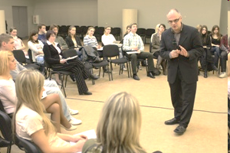
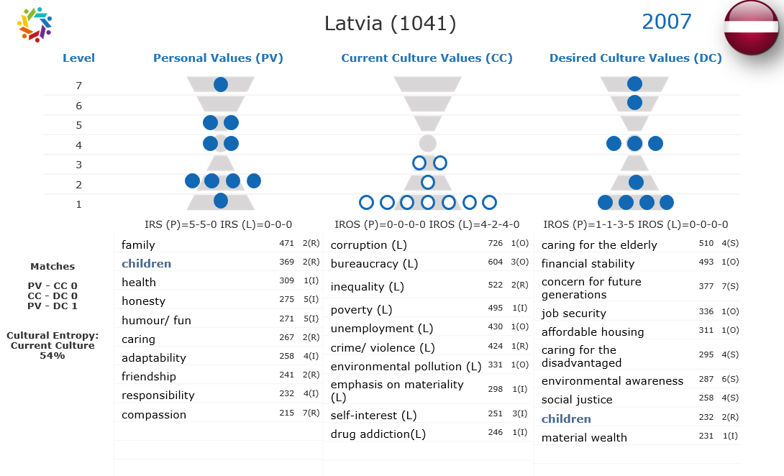
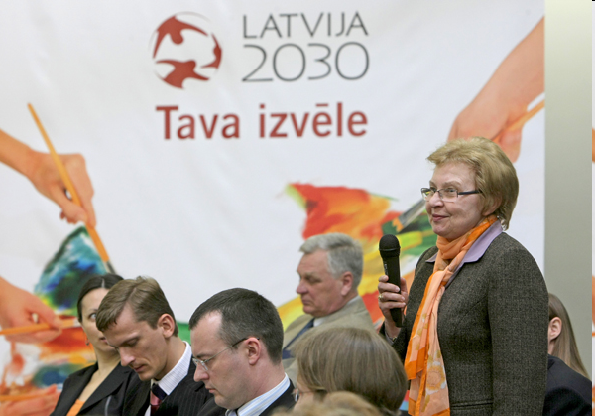
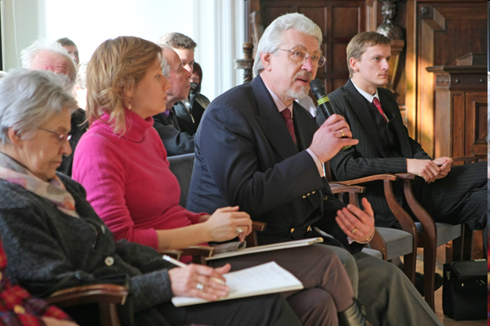
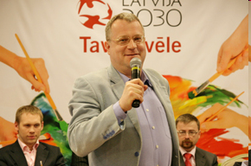
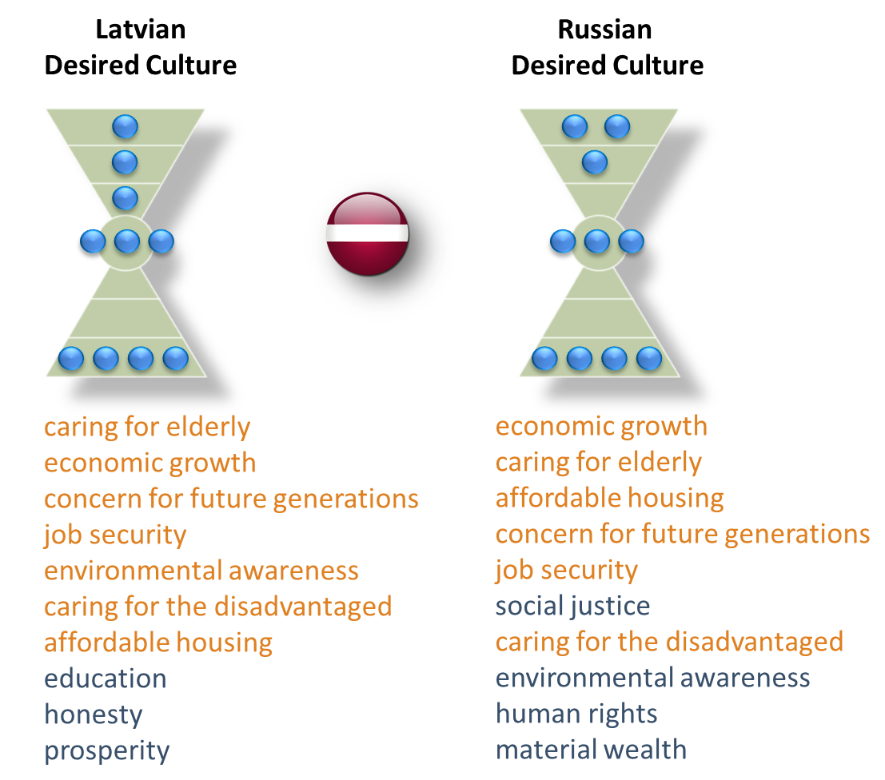
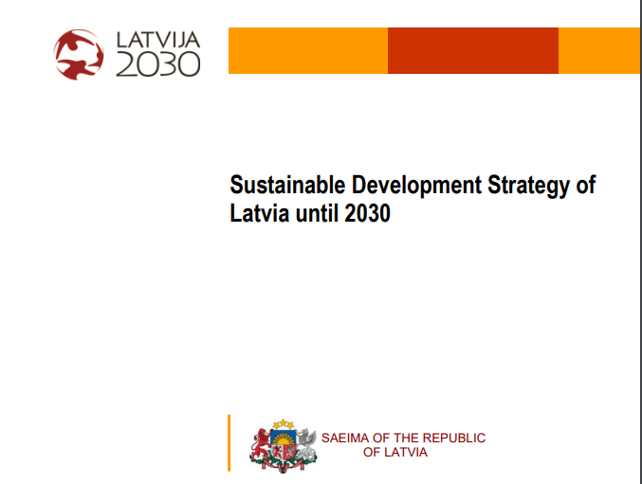
Latvia National Values Assessment 2007
Russian and Latvian teenagers talk about the values for more peaceful and harmonious race relations.
Latvia 2030 Sustainable Development Strategy
Based on the values and
needs of the people

Slide 56
MEASUREMENT MATTERS
MEASURING
NATIONAL WELL-BEING
WHATEVER YOU MEASURE TENDS
TO IMPROVE

Slide 57
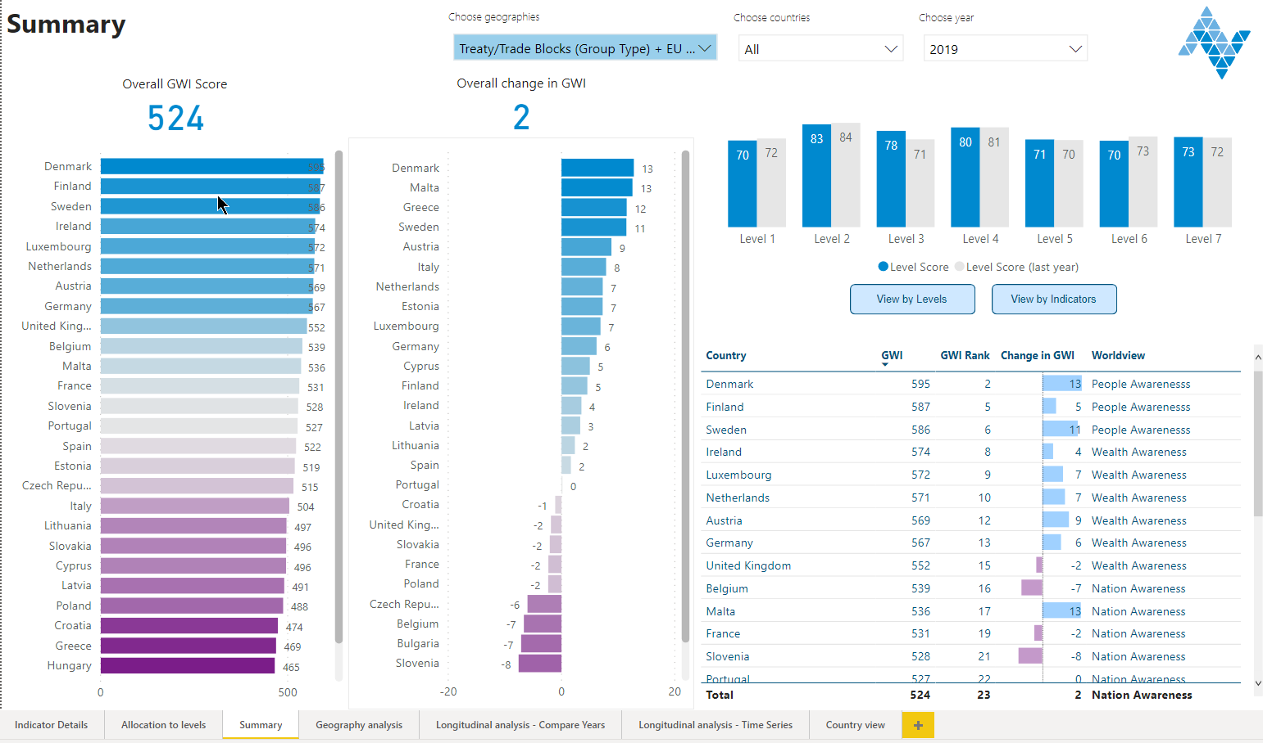
WELLBEING IN THE EU
2019 LATVIA
#22 IN THE EU
#22

Slide 58
WELLBEING IN THE EU
2018 – 2019
#14 IN IMPROVEMENT
#14

Slide 59
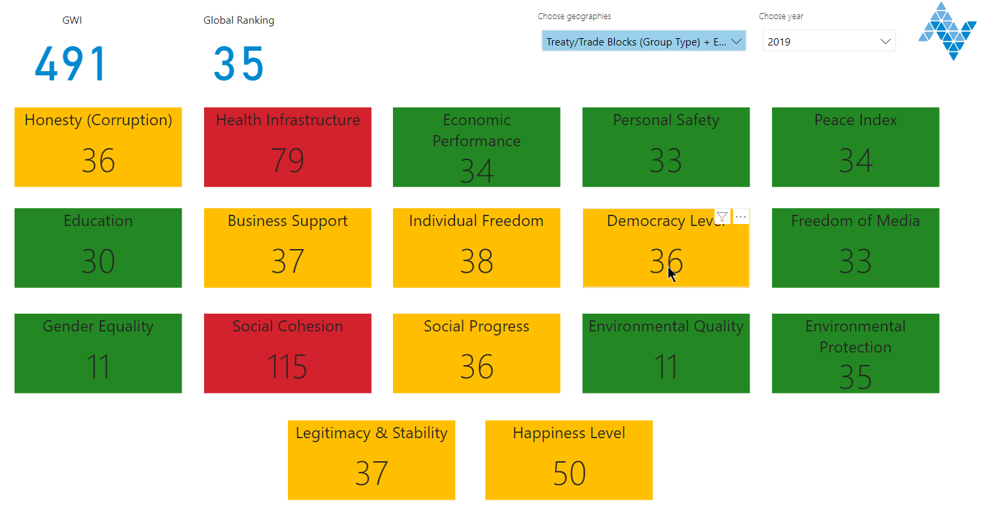
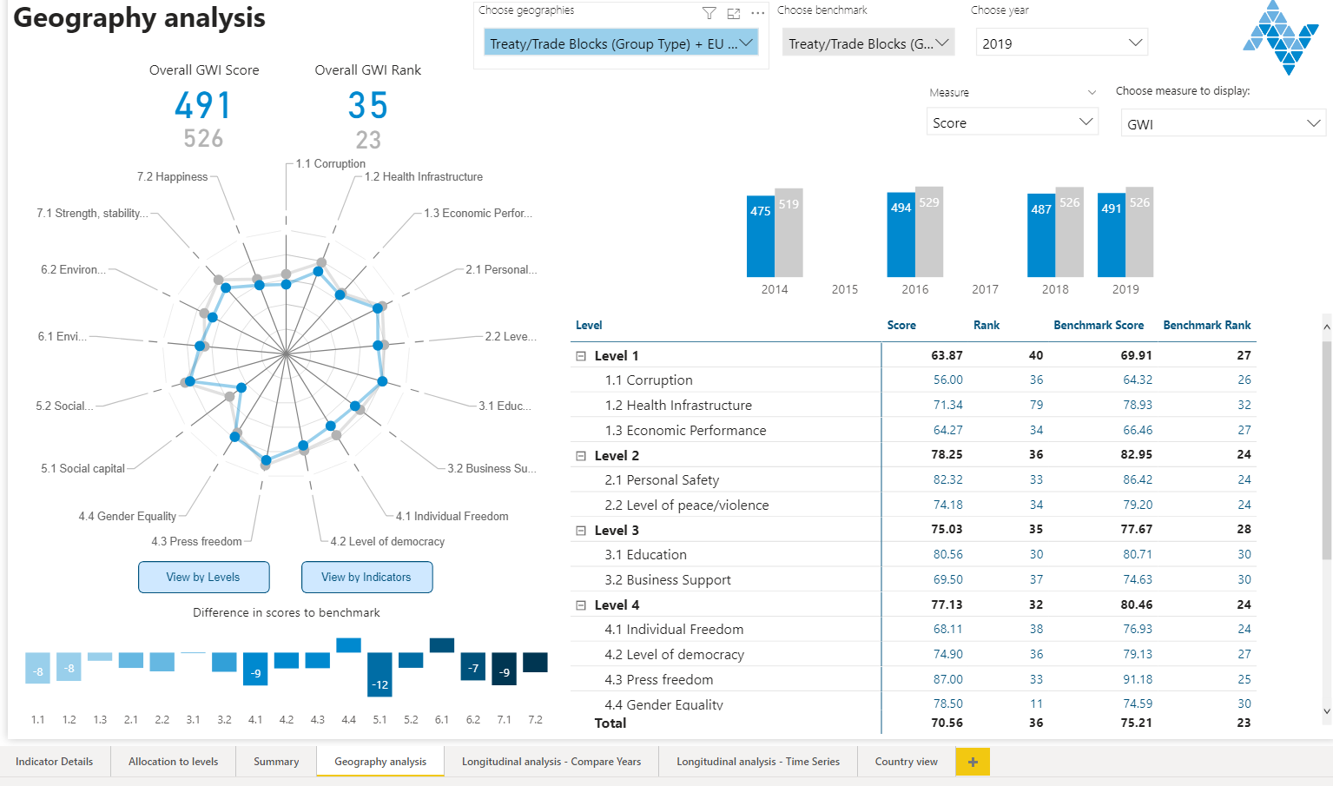
LATVIA: WELLBEING SCORE
ISSUES
LATIVA
EU AVG GWI

Slide 60
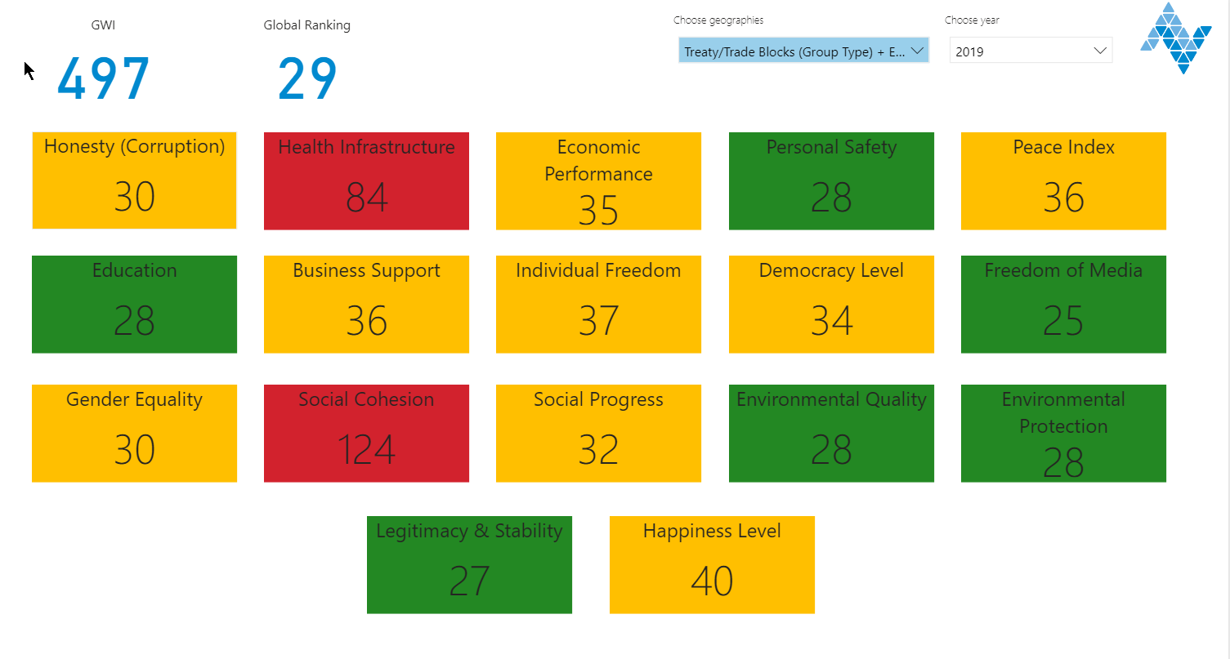
LITHUANIA: WELLBEING SCORE
ISSUES

Slide 61
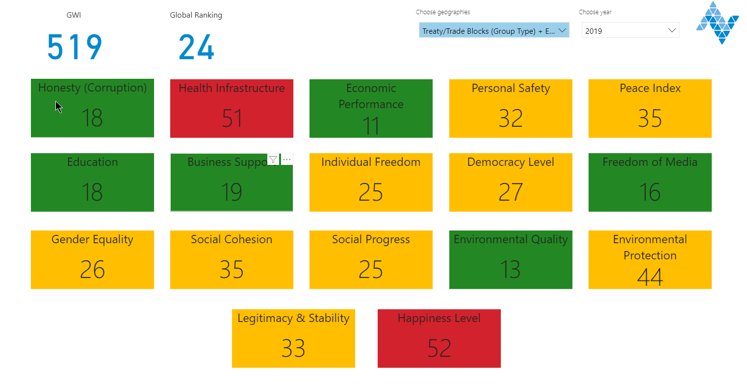
ESTONIA: WELLBEING SCORE
ISSUES

Slide 62
BARRETT ACADEMY FOR THE ADVANCEMENT OF HUMAN VALUES
FOR MORE INFORMATION
CONTACT:
Richard@barrettacaemy.com

